Slide 1
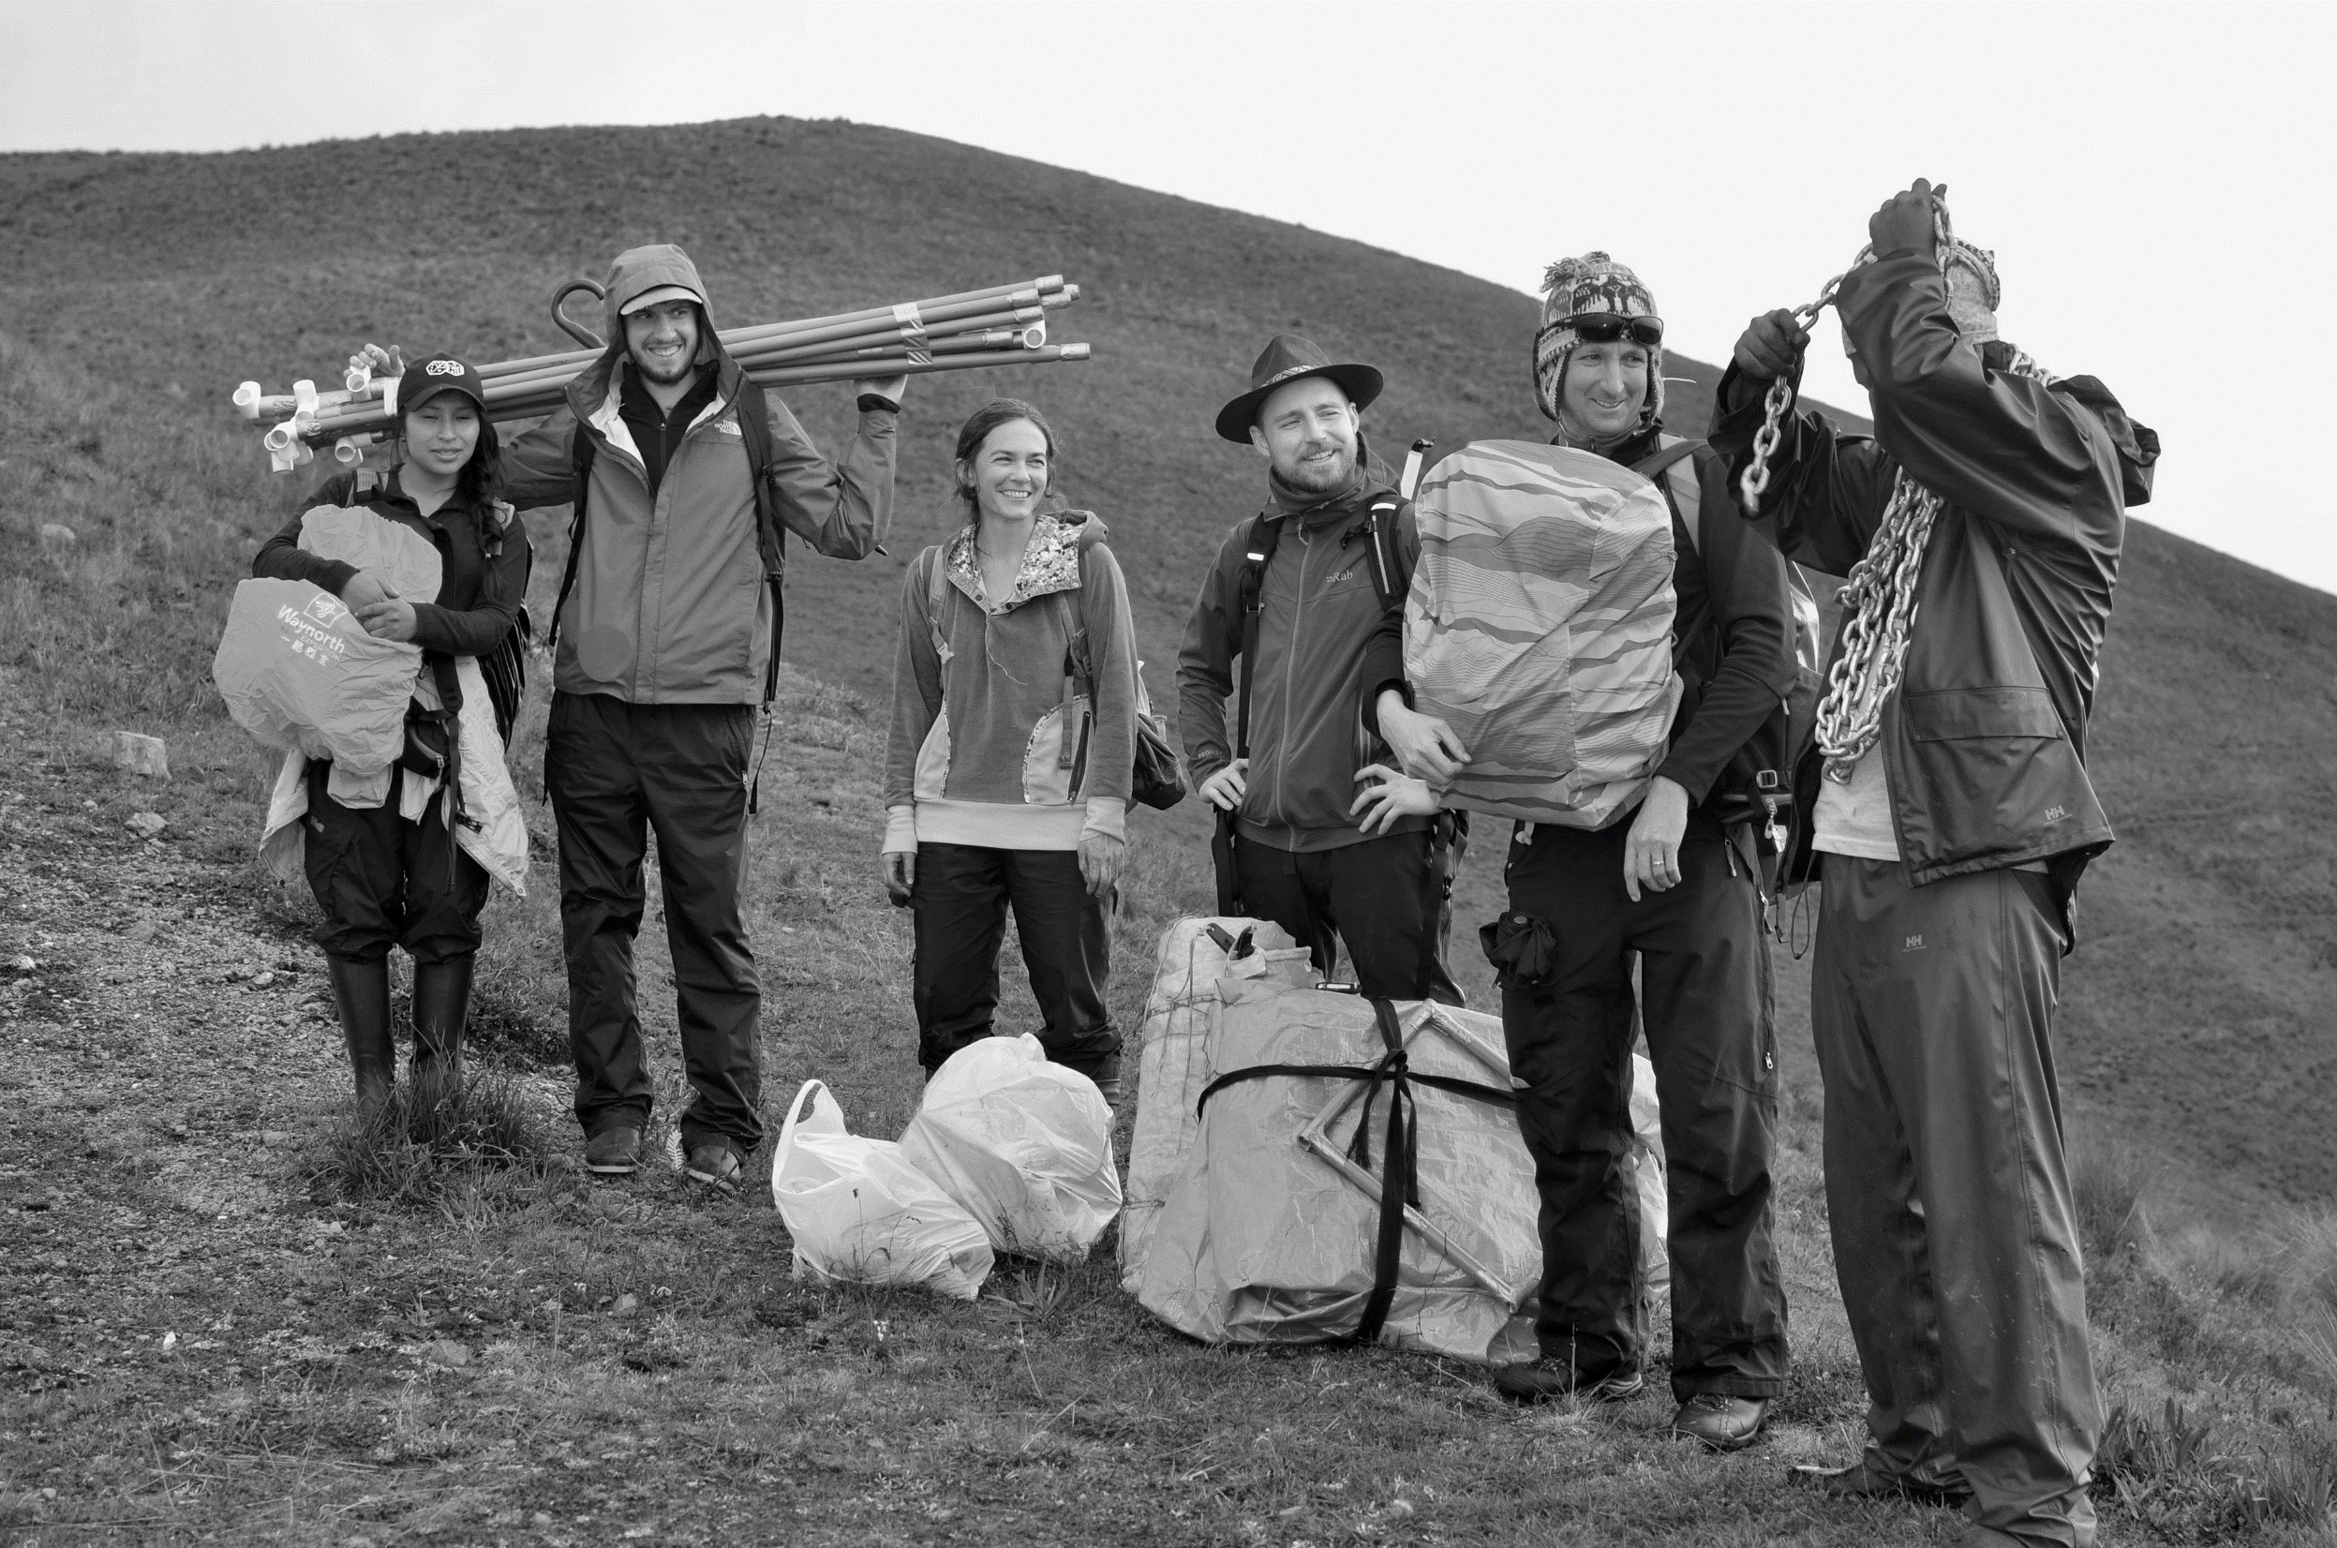
TEAM CO2

Slide 2
Team CO2 research goals
Meaure CO2 fluxes in Andean Puna grasslands across an elevational gradient
Quantify effects of burn history on Puna grassland CO2 exchange
Relate CO2 fluxes to changes in plant community composition and functional trait distributions

Slide 3
Team CO2’s science questions and hypotheses
1. How does elevation affect ecosystem CO2 exchange in Andean Puna grasslands?
Increased elevation reduces ecosystem CO2 uptake and release due to increasingly unfavourable environmental conditions

Slide 4
Team CO2’s science questions and hypotheses
2. Does burn history impact net ecosystem CO2 uptake and release in Andean Puna grasslands?
Increased elevation reduces ecosystem CO2 uptake and release due to increasingly unfavourable environmental conditions

Slide 5
Team CO2’s science questions and hypotheses
3. Which plant functional traits are important in determining ecosystem CO2 fluxes?
Puna plant communities with lower abundance-weighted SLA have greater productivity

Slide 6
Analyses to be done
Field measurements finished
Data processing – i.e. flux calculations and environmental metadata summaries
Standardization of data in relation to plant biomass, PAR, and temperature variations
Statistics across sites, treatments, PFTs

Slide 7

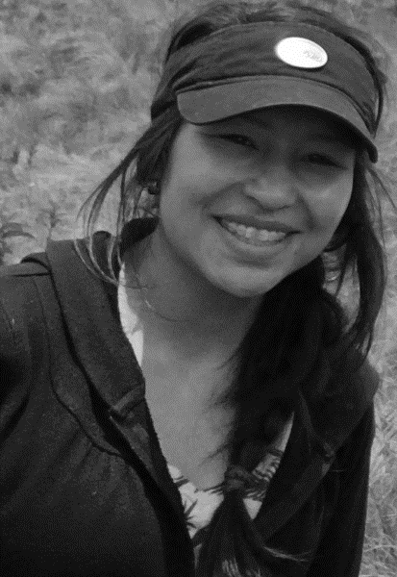
TEAM CO2 SAYS
THANK YOU FOR LISTENING

